Slide 1
ITSC 206: Advanced Networking for Offensive and Defensive Environments
Lecture 1: Fundamentals of Network Security
Notes:
PLEASE READ SLIDE NOTES

Slide 2
Table of Contents
Intro
Course Grading
Communication / Attendance
Network Review
Network Security
Threats
Defenses (Defense in Depth)
Wired vs Wireless Networks
Network Vulnerabilities
Security Toolbox

Slide 3
Intro
Instructor – Viktor Lyagutsky
Background
Class
Each student

Slide 4
Course Grading
Labs x 8
Quiz x 7
Mid Term Exam
Final Exam
15 %
10 %
35 %
40 %

Slide 5
Communication / Attendance
Instructor to Student
Email
Pre and post class (15 min)
During lecture / lab
Student to Instructor
Email pre and post class
Schedule appointment
Class/Lab/Quiz/Exam Attendance
Flexibility but communication is key

Slide 6
Network Review

Slide 7
What is a Network
A network is an interconnection of three or more communicating entities
A number of nodes connected by some sort of communications path
This can include but not limited to Ring, Dual Ring, Tree, Mesh, Bus, Star

Slide 8
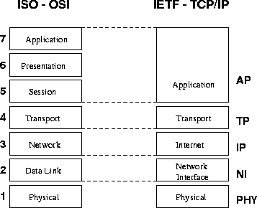
OSI / TCP Layers

Slide 9
IP Addresses v.4
Resides at the network layer, it must be capable of providing coms between hosts on different kinds networks (datalink or physical implementations)
Are usually shown in dotted decimal notation of 32 bits eg 1.2.3.4
00000001 00000010 00000011 000000100
The IP consists of the Network ID and Host ID that are used for routing through ASN’s (Autonomous System Number).

Slide 10
Internet Address Classes
Class A
128 possible network Ids
over 4 million host Ids per network
Class B
16k possible network ids
64k possible host ids per network
Class C
over 2 million possible network ids
about 256 hosts ids per network
Class D is used for multicasting
Class E is used for experimentation

Slide 11
Subnetting
An organization can subdivide it’s host address space into groups called subnets.
The subnet ID is generally used to group hosts based on the physical network topology.
Can simplify routing and security
create a dynamic network

Slide 12
Network Address Translation
Internal hosts can be assigned various internal (non-routeable) addresses eg
Range 1: Class A - 10.0.0.0 through 10.255.255.255 /8
Range 2: Class B - 172.16.0.0 through 172.31.255.255 / 12
Range 3: Class C - 192.168.0.0 through 192.168.255.255 /16
see RFC 1631
Increased the life span of IP v4
can be used for load balancing
can be used for back up links (multihomed)

Slide 13
IP V4 vs V6

Slide 14
TCP/IP Summary
IP: Network layer protocol
unreliable datagram delivery between hosts
UDP: Transport layer protocol
unreliable datagram delivery between processes
TCP: Transport layer protocol
reliable, byte-stream delivery between processes
https://en.wikipedia.org/wiki/Network_security
Notes:
Having said that, it means not only computer information, but all kinds of information like coded letters

Slide 15
Common Network Services
SMTP, POP
Telnet
FTP, TFTP
DNS
Gopher
http
NFS
NIS
X Windows
Rlogin
wms & rtsp
RDP
ssh
etc

Slide 16


Architecture Review
10.1.1.1/192.168.123.1
Remote
Access
10.1.1.2
Internet
10.1.2.1/192.168.123.2
10.1.2.2
10.1.3.1/192.168.123.3
192.168.123.0/24
10.1.3.2
10.1.4.1/192.168.123.4
InternalServers
10.1.4.2

Slide 17
Network Security

Slide 18
What is Network Security?
“Network security consists of the policies and practices adopted to prevent and monitor unauthorized access, misuse, modification, or denial of a computer network and network-accessible resources. Network security involves the authorization of access to data in a network, which is controlled by the network administrator. Users choose or are assigned an ID and password or other authenticating information that allows them access to information and programs within their authority.”
https://en.wikipedia.org/wiki/Network_security
Notes:
Having said that, it means not only computer information, but all kinds of information like coded letters

Slide 19
Network Security Goals
Confidentiality
Guarantees network data is transmitted in a confidential manner
Integrity
Guarantees network data is transmitted in the original representation, unchanged
Availability
Guarantees network data is accessible when it is requested

Slide 20
Confidentiality
Protection against sensitive information from unauthorized disclosure or intelligible interception by unauthorized entities.
Cryptography and access control are used to protect confidentiality;
Encryption call be applied to any layer in the OSI stack, commonly done at the network layer;
There are three forms of access control;
Administrative
Physical
Logical

Slide 21
cont - Confidentiality
Access control is the process of limiting the privileged use of system resources;
Administrative controls based on policies which state the objectives regarding controls over access to resources, hiring and management of personnel, and security awareness;
Physical controls by limiting access to anywhere that contain restricted assets of network nodes and wiring;
Logical controls are the hardware and software means of limiting access which includes access control lists, communication protocols, file system permissions and cryptography

Slide 22
Data Integrity
Ensure that software or information is complete, accurate and authentic
network integrity is when the message is received complete and unmodified between valid source and destination;
Message Authentication Codes, Hash function
Connection integrity can be accomplished by using cryptography and routing control;
Encryption
Vetting, templates
Trace Files, Logs (for recovery)

Slide 23
System Integrity
Configuration Management
Perimeter Defense
Intrusion Monitoring (IDS, A/V)
Trusted Distribution
Policies (AUP, S/W Control, Info Handling)
Personnel Security
Physical Security
Access Control

Slide 24
Availability
Ensure that resources (including information) are available and functional.
Using systems that are designed with
redundancy,
fault tolerance (failover),
Reliability (resilience),
backups & recovery, and
load balancing
End users view availability as being the entire system - applications, servers & network
Since 2000, large web sites Yahoo!, eBay, Amazon, CNN etc the focus of attack for hours/days with Distributed Denial of Service Attack

Slide 25
Network Security Controls
Include network access controls to enforce access policies (e.g., NAC, firewalls, IDPS, web and email content security)
Authentication (e.g., login credential, multi-factor authentication)
Encryption technology secures communications between hosts or networks

Slide 26
Info vs OT Security Triad
Information
Technology
Operational
Technology
Integrity
Confidentiality
VS
Integrity
Confidentiality
Reliability
Resilience
Availability
Availability

Slide 27
Discussion

Slide 28
Defense in Depth

Slide 29
Defense in Depth
Defense in Depth is a concept borrowed from military
The idea is simple:
Use multiple layers of defense to delay an incoming attack by yielding space to buy time
Because attackers must work through different defense layers to access internal resources, the attack has higher chance of being detected, giving the organization time to respond
In network security, defense in depth includes multiple layers of firewalls, DMZ, IDS/IPS, antivirus, web filtering, etc.

Slide 30
Defense In Depth
Like an Onion (a layered approach)
Each layer using different technologies or management controls
Perimeter of Network
Internal Network
Human Factor
30

Slide 31
Defense In Depth
The Perimeter – No Maginot Line
“Do not strike at strength … attack that which is weak…” - Sun Tzu
Routers
Firewalls
IDS’s
VPN Devices
Software
OS, App, DB
DMZ’s and subnets
Perimeter
Defenses
31

Slide 32
Defense In Depth
Internal Network – The inner network safeguards
IDPS, Personal Firewalls
A/V Software
Software Hardening
OS patches etc
Only needed
Services running
Configuration Mgmt
Audits
Internal
Defenses
32

Slide 33
Defense In Depth
Human Factor – The people connected to our systems
Policies, Standards & Procedures
A/V Policy, AUP
Standards of Employee Conduct
BCP Procedures
Awareness Program
Sign AUP Annually
Security tip of the week
Advertise Best Practices
Human
Defenses
33

Slide 34
Discussion

Slide 35
Network Security Threats

Slide 36
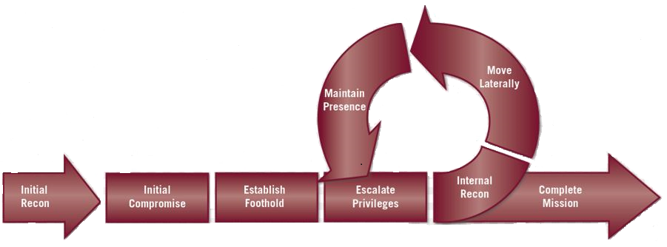
Threats – Enhanced Cyber Kill Chain

Slide 37
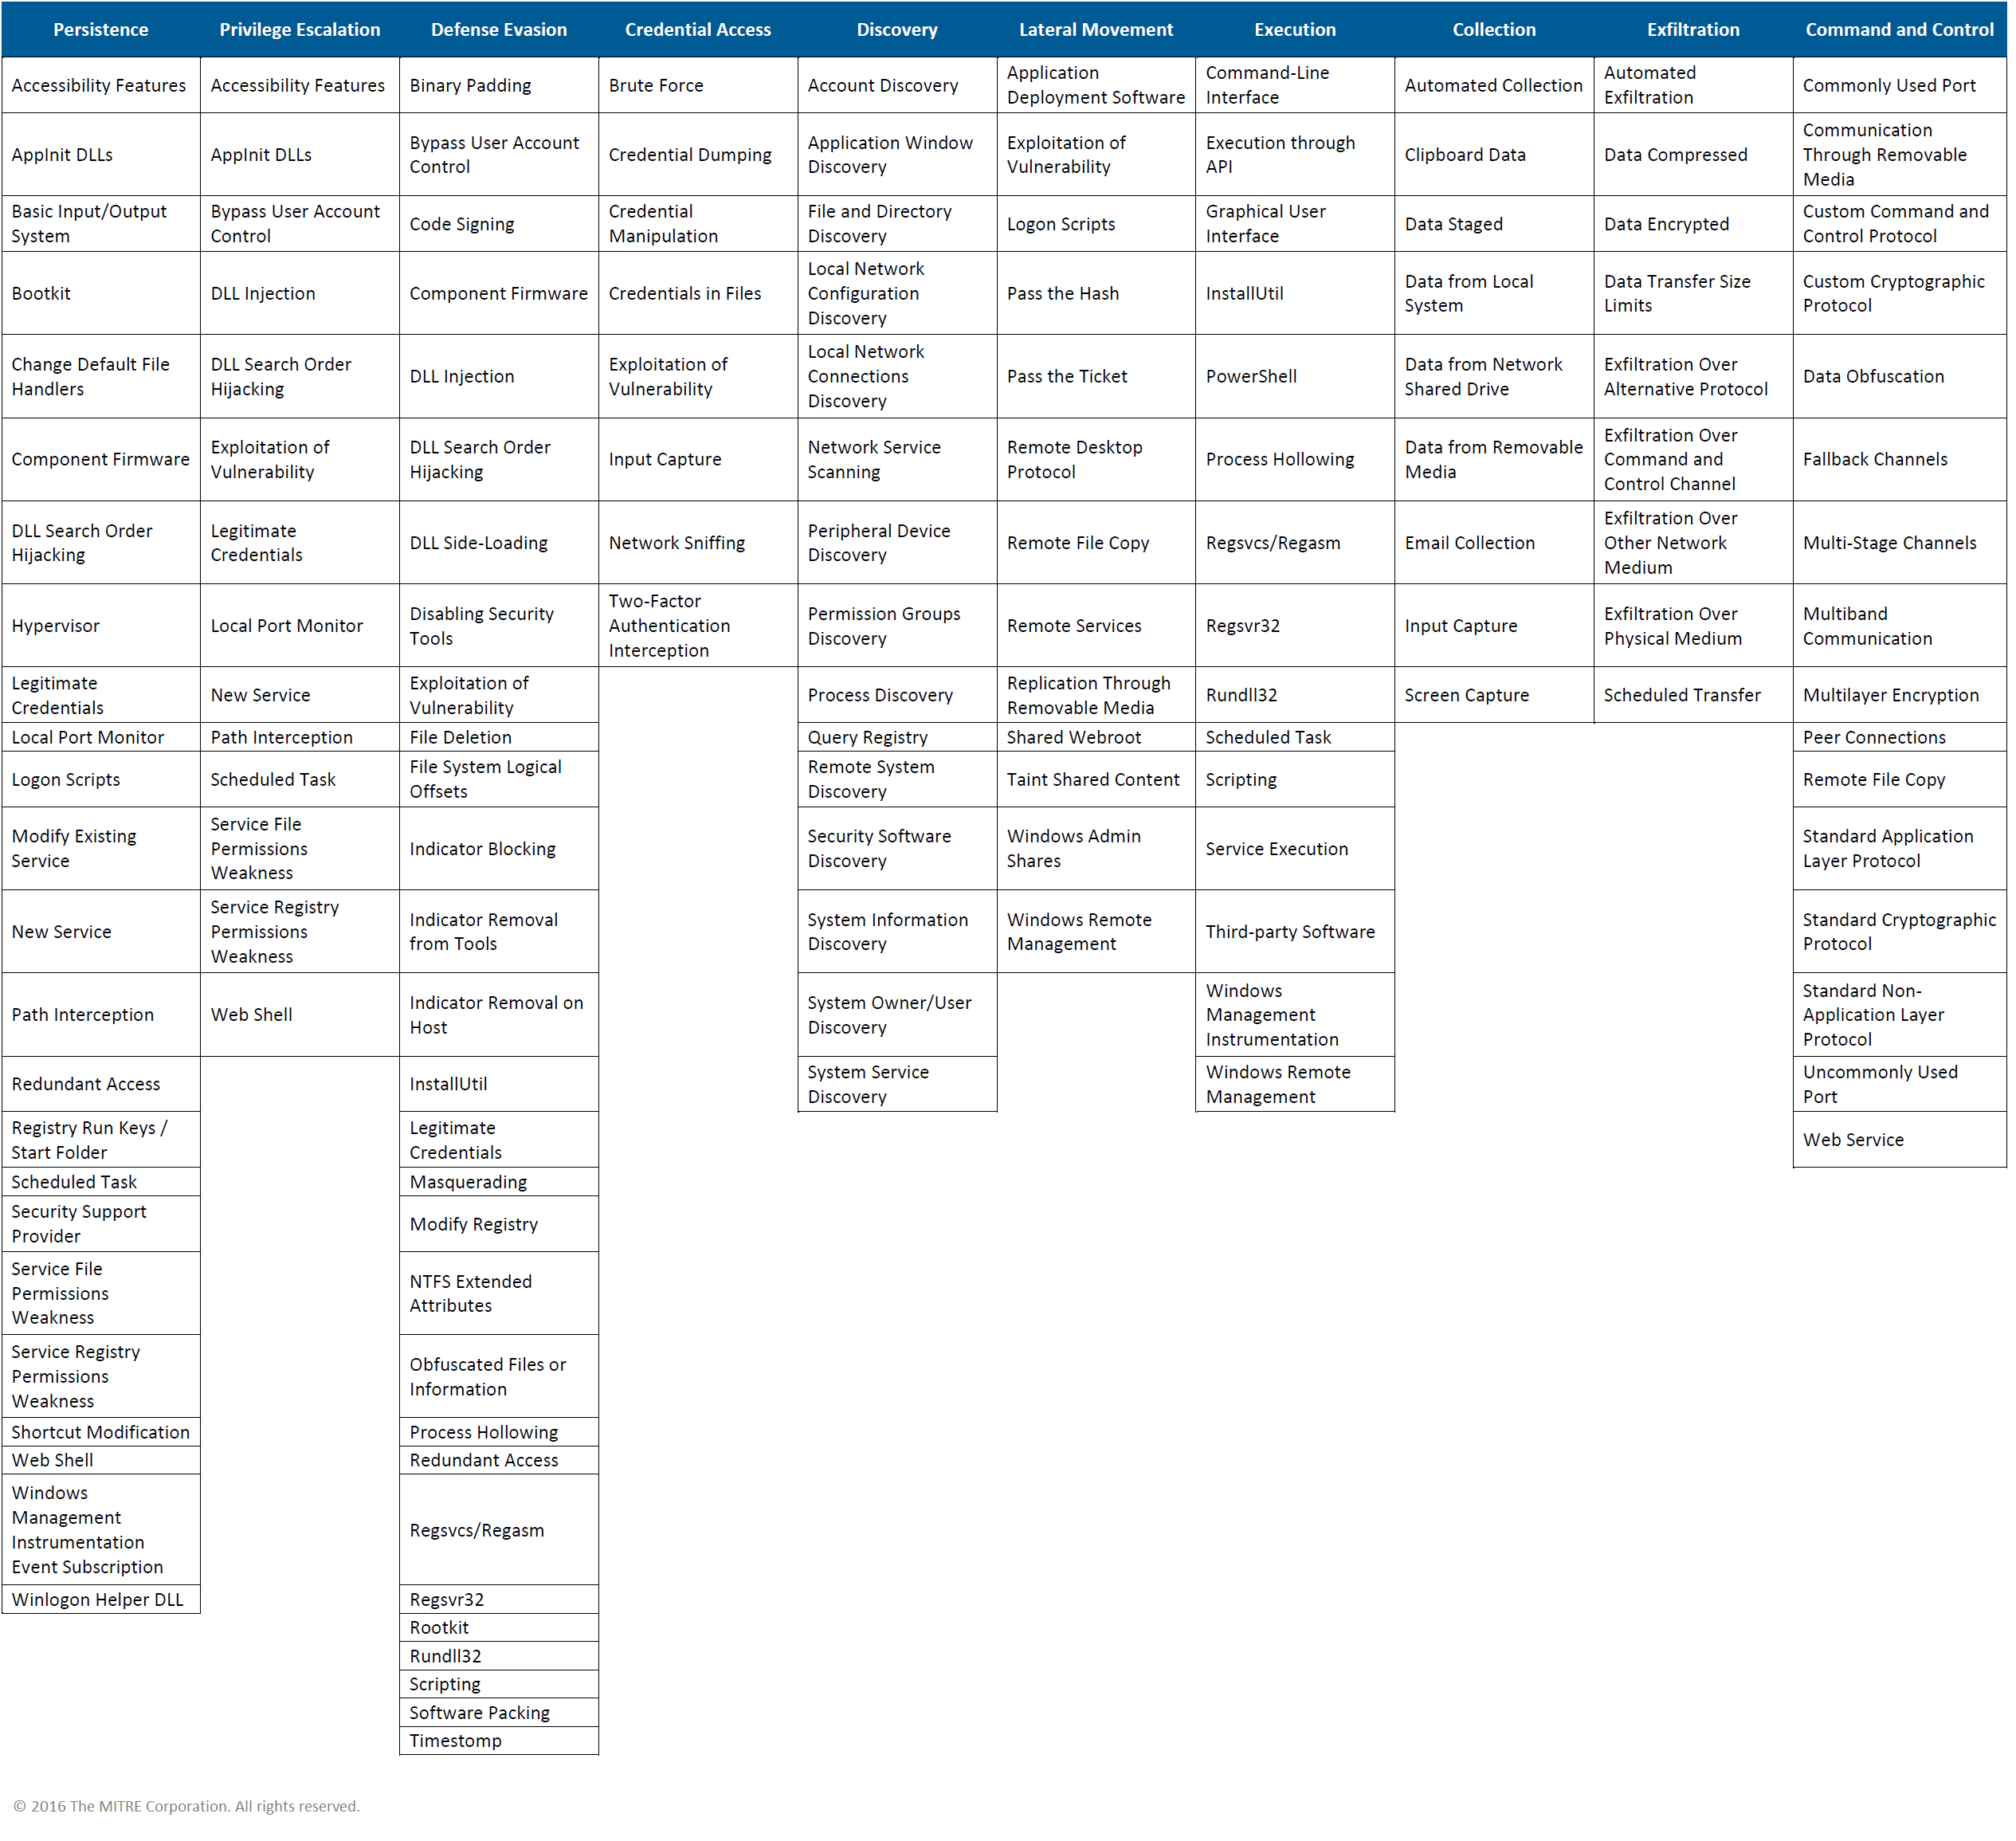
Threats – Mitre ATT&CK Matrix

Slide 38
Common Network Security Attacks
Network Attack
Wiretapping (sniffing)
Port scanners (IP, port etc)
Idle scans
DoS attacks
MAC, IP, DNS, DHCP spoofing
Man-in-the-middle attacks
ARP, DHCP poisoning
VLAN hopping
Smurf attacks

Slide 39
Common Network Security Attacks
Network & OS Attack
Buffer overflows
Heap overflows
Format string attacks
App attacks
SQL injections
Cross-site scripting
CSRF
Phishing

Slide 40
Discussion

Slide 41
Measures of Network Security

Slide 42
Network Security Defenses
Network segmentation / Firewalls
Network & OS Access controls
Behavioral analytics (Network / End Point)
Intrusion Detection System (IDS)
Intrusion Prevention Systems (IPS)
Data loss prevention (DLP)
Antivirus and antimalware (Network / End Point)
Email / Web security

Slide 43
Network Security Defenses
Security information and event management
Virtual Private Network (Net to Net, EP to Net)
Application security
Wireless security
Mobile device security

Slide 44
Discussion

Slide 45
Wired vs. Wireless Networks

Slide 46
Wired Network
Faster speed – up to 40 Gbps
Full duplex, collision free
Harder to sniff traffic
More reliable transmission
Requires physical connectivity, restricts mobility
More secure in general

Slide 47
Wireless Network
Slower speed – up to 2.3 Gbps (theoretically)
Shared medium, prone to collision
Easy to sniff traffic
Prone to transmission errors
Does not require physical connectivity
Less secure in general

Slide 48
Discussion

Slide 49
Network Vulnerabilities

Slide 50
Vulnerability Sources
Vendors
Networks
Avaya, Cisco, F5, Fortinet, Juniper, HP, Palo Alto, etc
OS
IBM, Linux, Microsoft, Oracle
Apps
US-CERT - www.us-cert.gov
CVE Mitre - cve.mitre.org

Slide 51
Identify Network Security Vulnerabilities
Research common network attacks
Perform an inventory of your network devices
Look up vulnerabilities associated with your devices
Employ vulnerability assessment tools
Assess the risks on all your devices

Slide 52
Internal Network Vulnerabilities
Network Perimeter – A line of defense established between the network you manage (your corporate network) and the outside network (the Internet)
Internal network vulnerabilities can be exploited from within the network perimeter
Vulnerabilities on workstations, servers, network devices, storage components, infrastructure nodes, etc.

Slide 53
External Network Vulnerabilities
External network vulnerabilities can be exploited from outside the network perimeter
Vulnerabilities on Internet-facing web servers, services, database, VPNs, firewalls, etc.

Slide 54
Discussion

Slide 55
Security Toolbox

Slide 56
Testing Frameworks
OWASP – Open Web Application Security Project
https://www.owasp.org
PTES – Penetration Testing Execution Standard
http://www.pentest-standard.org
OSSTMM – Open Source Security Testing Methodology Model
http://www.isecom.org/research/osstmm.html

Slide 57
Security Toolbox: Kali
Kali(BackTrack)
https://www.kali.org
Kali used as an offensive security tool to perform penetration testing
Standard tool for security analysts
This course uses Kali to perform most of the offensive network attacks
Download and install Kali into a VM environment
Samurai Security Testing Framework
http://www.samuraistfu.org/
PTF – Penetration Testers Framework
https://github.com/trustedsec/ptf

Slide 58
Kali Demo

Slide 59
Next Lecture
Read
Quiz?
Exam?

Slide 60
© 2017, Southern Alberta Institute of Technology. All rights reserved.
This publication and materials herein are protected by applicable intellectual property laws. Unauthorized reproduction and distribution of this publication in whole or part is prohibited.
For more information, contact:
Director, Centre for Instructional Technology and Development
Southern Alberta Institute of Technology
1301 16 Ave. N.W., Calgary, AB T2M 0L4

Slide 61
ITSC 206: LAN Networking for Offensive and Defensive Environments
Lecture 2: Secure the Local Area Network. (LAN)

Slide 62
Table of Contents
Review Lecture & Lab
MAC Address Spoofing
ARP Address Spoofing
VLAN Hopping
DHCP Starvation
DHCP Server Spoofing
IP Spoofing
STP Spoofing
Private VLan

Slide 63
Review Lecture & Lab

Slide 64
Review
Network Security
Threats
Defenses (Defense in Depth)
Wired vs Wireless Networks
Network Vulnerabilities
Security Toolbox
Lab: Architecture Review, Packet Investigation & Vulnerability Analysis

Slide 65
Threats, Vulnerabilities, Safeguards & Assets
Assets
Threat
Data
Facilities
Hw/Sw
Safeguards
Threat
Vulnerability
Threat
Safeguards

Slide 66
MAC Address Spoofing

Slide 67
MAC Address Spoofing
Very simple network attack technique
Attacking device can spoof a MAC address, registering itself as a different network node on the switch
This network attack technique serves as the basis for many higher-level network attacks
Including CAM overflow, ARP spoofing, DHCP starvation and DHCP server spoofing

Slide 68
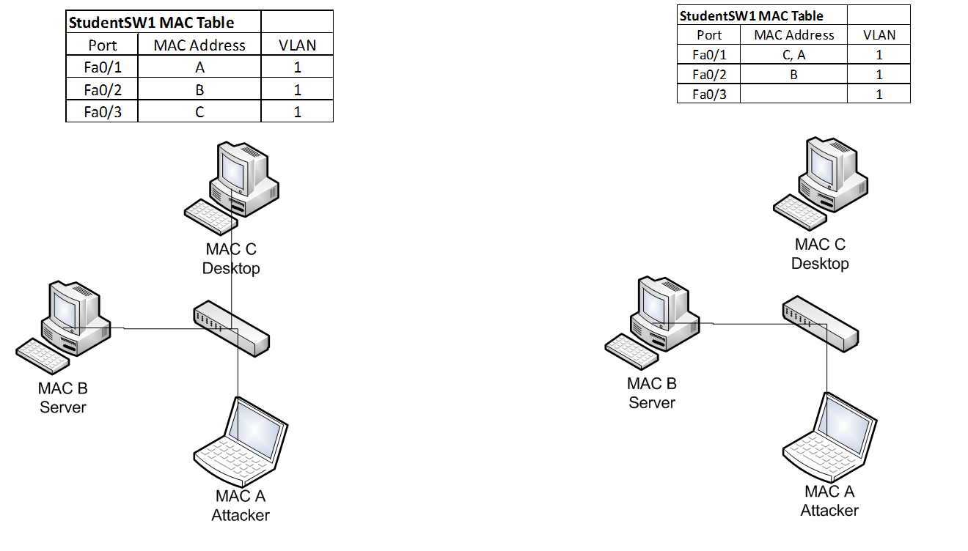
MAC Address Spoofing

Slide 69
MAC Address Spoofing Prevention
To mitigate MAC address spoofing:
Configure Port security on all access ports to limit the number of allowed MAC address registrations
Configure the violation types and the aging timers
Switch(config)# int range fa0/1-24
Switch(config-if-range)# switchport mode access
Switch(config-if-range)# switchport nonegotiate
Switch# show interfaces truck
Switch(config-if)# switchport port-security
Switch(config-if)# switchport port-security maximum 3
Switch(config-if)# switchport port-security mac-address sticky
Switch(config-if)# switchport port-security mac-address 0016.cb96.9594
Switch# switchport port-security violation {shutdown | restrict | protect}
Switch(config)#vlan 666
Switch(config)# int range fa0/2-24
Switch(config-if-range)# switchport access vlan 666

Slide 70
Discussion

Slide 71
ARP Spoofing

Slide 72
ARP Spoofing
Network attack designed to take over traffic for the targeted IP address (man-in-the-middle)
Relies on ARP protocol to associate the attacker’s MAC address to an IP address on the same LAN segment
Successful execution allows attacker to hijack network traffic for the targeted IP address
Particularly useful for spoofing a network gateway

Slide 73
ARP Spoofing
ARP spoofing builds on MAC address spoofing
Can be achived by sending specially crafted G-ARP packets to announce the MAC address for the target IP address on a particular network port
By repeatedly sending G-ARP packets, the MAC address is repeatedly associated with the attacker’s network port in the CAM table
Also, other hosts on the network intercept and store the attacker’s MAC address for the target IP address

Slide 74
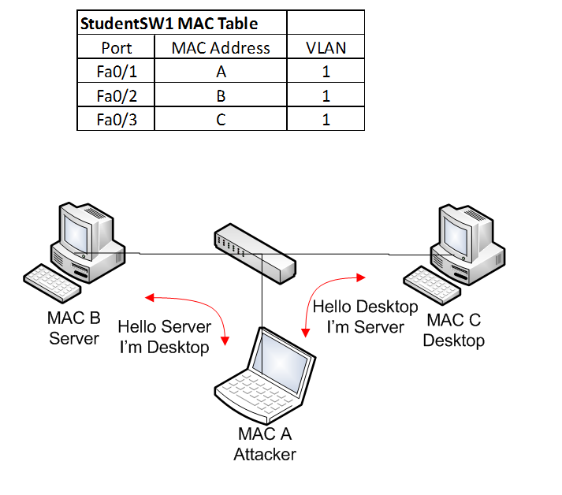
ARP Spoofing

Slide 75
ARP Spoofing Prevention
To mitigate ARP spoofing
Similar to MAC Spoofing Mitigation; and
Enable Dynamic ARP Inspection (DAI) on Switch
Intercepts all ARP requests (DHCP snooping) and responses on untrusted ports prevents a class of man-in-the-middle attacks
The switch drops ARP packet if the sender MAC address and sender IP address do not match an entry in the DHCP snooping bindings database
ip arp inspection vlan
Static ARP mappings.
A static mapping associates an IP address to a MAC address on a VLAN.
Useful when static IP addresses are used, DHCP snooping cannot be run, or other switches in the network do not run dynamic ARP inspection.

Slide 76
Discussion

Slide 77
VLAN Hopping

Slide 78
VLAN Hopping
A layer 2 network attack that targets the switch to gain access to a VLAN that is not accessible.
2 Types of attacks:
Posing as a switch connected with a VLAN trunk,
Double-tagging a VLAN to “hop” to another VLAN.

Slide 79
VLAN Hopping via Trunk Port
Posing as a switch, the attacking device can request the switch port to negotiate a trunk using Dynamic Trunking Protocol (DTP)
Once a trunk is established, the connected device can send and receive different VLAN traffic
Can access restricted VLANs (e.g., management VLAN)
This type of network attack is effective with physical access to the LAN environment

Slide 80
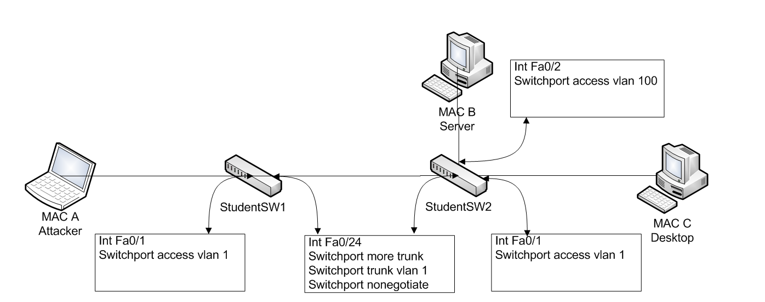
VLAN Hopping via Trunk Port

Slide 81
VLAN Hopping via Double Tagging
The double tagging attack is when connected to an interface in access mode with the same VLAN as the native untagged VLAN on the trunk.
The attacker sends a frame with two 802.1Q tags, the “inner” VLAN tag is the VLAN that we want to reach and the “outer” VLAN tag is the native VLAN.
When the switch receives the frame, it will remove the first (native VLAN) 802.1Q tag and forwards the frame with the second 802.1Q tag on its trunk interface(s).
The attacker has now “jumped” from the native VLAN to the victim’s VLAN. It’s a one way trip but it could be used perhaps for a DOS attack.

Slide 82
VLAN Hopping via Double Tagging
Tag
20
IP
Switch 1
Switch 2
IP
Tag
1, 20
IP
Attack Device
Victim
Device
VLAN 1
VLAN 20

Slide 83
VLAN Hopping Prevention
To mitigate VLAN hopping via trunk port:
Similar to MAC Spoofing Mitigation; and
Do not put any hosts on VLAN 1 (the default VLAN);
Change the native VLAN on all trunk ports to an unused VLAN ID;
Explicit tagging on the native VLAN on all trunk ports.

Slide 84
Discussion

Slide 85
DHCP Starvation

Slide 86
DHCP Starvation
Network attack targeting the exhaustion of a DHCP client IP from an authorized DHCP server
Using MAC address spoofing, an attacking device sends large numbers of DHCP requests using different “fake” MAC addresses
Once exhausted, the network DHCP server no longer has an available DHCP client IP to offer
This causes a Denial of Service (DoS) on the target network
DHCP starvation also serves as the basis of DHCP server spoofing attacks

Slide 87
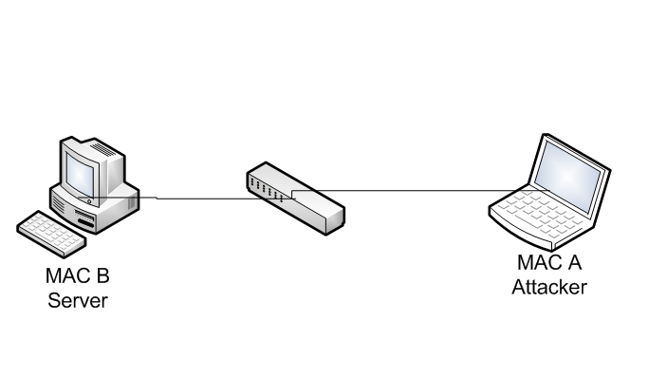
DHCP Starvation

Slide 88
DHCP Starvation Prevention
To mitigate a DHCP starvation attack
Similar to MAC Spoofing Mitigation; and
Enable DHCP snooping on switch to prevent an unauthorized DHCP server from responding to DHCP requests

Slide 89
Discussion

Slide 90
DHCP Server Spoofing

Slide 91
DHCP Server Spoofing
Network attack a rogue DHCP server poses as a legitimate DHCP server for the network segment
Since the DHCP server provides network gateway, DNS information, WPAD configuration, etc.,
DHCP server spoofing is the basis for many other higher-level network attacks, such as gateway spoofing, DNS spoofing and proxy spoofing

Slide 92
DHCP Server Spoofing
DHCP server spoofing relies on DHCP starvation attacks
If DHCP starvation attack is successful, the legitimate DHCP server no longer offers DHCP client IPs
The rogue DHCP server starts offering DHCP servers on the network from its own pool of IP addresses (typically from the exhausted pool of IPs obtained from the DHCP starvation attack)

Slide 93
DHCP Server Spoofing

Slide 94
DHCP Server Spoofing Prevention
To mitigate DHCP server spoofing
Similar to MAC Spoofing Mitigation; and
Enable Port security on switch, limits the number of MAC addresses connected to switch port
The attack relies on DHCP starvation attacks, mitigating DHCP starvation attacks also mitigates DHCP server spoofing
Enable DHCP snooping on switch to prevent an unauthorized DHCP server from responding to DHCP requests

Slide 95
Discussion

Slide 96
IP Spoofing

Slide 97
IP Spoofing
Network attack to hijack another IP address
Can hijack traffic destined for the target host
Builds on ARP spoofing to be successful
Attacker can repeatedly send G-ARP for a target IP address and redirects IP traffic to the attacker’s port
In its simplest form, attacker can change the IP address of a host and cause an IP address conflict (and DoS) on the target IP

Slide 98
IP Spoofing

Slide 99
IP Spoofing
To mitigate an IP spoofing attack
Similar to MAC Spoofing Mitigation; and
Use IP Source Guard to further restrict IP spoofing

Slide 100
Discussion

Slide 101
Spanning Tree Protocol Spoofing

Slide 102
Spanning Tree Protocol Spoofing
Network attack that changes the STP topologies to force network traffic to traverse a rogue network device
By controlling the rogue network device, attacker can sniff all passing network traffic and perform man-in-the-middle attacks

Slide 103
Spanning Tree Protocol Spoofing
Uses a rogue network device to pose as the ROOT bridge in a STP network
By injecting BPDU frames with the lowest priority, the rogue network device can become the elected ROOT bridge and change the topology in a STP network
Network traffic begins flowing through the ROOT bridge, allowing sniffing and man-in-the-middle attacks

Slide 104
STP Spoofing

Slide 105
STP Spoofing Prevention
To mitigate STP spoofing
Similar to MAC Spoofing Mitigation
Configure network ports with BPDU guard and ROOT guard
Configure non-trunk ports to switch access ports

Slide 106
Discussion

Slide 107
Private VLAN

Slide 108
Private VLAN
A private VLAN is used to provide additional segregation between all network hosts within the same VLAN
Especially useful for sensitive data servers that require port isolation to established secure hosting
A private VLAN includes Primary VLAN, Secondary VLAN (isolated and community), Promiscuous port, Isolated port and Community port

Slide 109
Private VLAN
 | Isolated Port | Promiscuous Port | Community Port
Isolated Port | Deny | Permit | Deny
Promiscuous Port | Permit | Permit | Permit
Community Port | Deny | Permit | Permit

Slide 110
Discussion

Slide 111
© 2017, Southern Alberta Institute of Technology. All rights reserved.
This publication and materials herein are protected by applicable intellectual property laws. Unauthorized reproduction and distribution of this publication in whole or part is prohibited.
For more information, contact:
Director, Centre for Instructional Technology and Development
Southern Alberta Institute of Technology
1301 16 Ave. N.W., Calgary, AB T2M 0L4

Slide 112
ITSC 206: Advanced Networking for Offensive and Defensive Environments
Lecture 3: Advanced Routing Protocols

Slide 113
Table of Contents
Review Lab 2
Routing Information Protocol (RIP)
RIP Attacks
RIP Attack Mitigation
Open Shortest Path First (OSPF)
OSPF Attacks
OSPF Attack Mitigation
Border Gateway Protocol (BGP)
BGP Attack
BGP Mitigation

Slide 114
Review Lecture & Lab

Slide 115
Review
MAC Address Spoofing
ARP Address Spoofing
VLAN Hopping
DHCP Starvation
DHCP Server Spoofing
IP Spoofing
STP Spoofing
Private VLan
Lab: Secure LAN

Slide 116
Routing Information Protocol (RIP)

Slide 117
RIP
Routing Information Protocol (RIP) is a distance-vector routing protocol
It uses hop count as a metric to measure distance
Maximum number of hops allowed: 15
A hop count of 16 is considered infinite and unreachable
Routing update sent out every 30 seconds using
broadcast in version 1
multicast in version 2

Slide 118
RIP
The frequency of routing updates tends to be relatively noisy on network
Because updates are sent every 30 seconds, there is a tendency for all RIP routers to send updates within seconds of each other, creating a storm of updates every 30 seconds, particularly in version 1
Version 1 does not support router authentication, making it prone to attacks

Slide 119
RIP: Split Horizon
Split horizon rule is used in RIP to prevent routing loop
Consider router A, B and C:
When A receives a route to C from B, it does not advertise back to B
This ensures B does not get an advertisement from A claiming that A has a route to C (via B) and creating a routing loop
A
X
B
C
Route to C

Slide 120
RIP: Route Poisoning
Used to prevent router from routing packets through an invalid network
RIP uses route poisoning to announce a route is no longer valid and should be removed from routing table
It does it by announcing a route with hop count 16, which marks it as unreachable, causing all RIP routers to remove the route from routing table
Route to Z Up/Down
Route to Z – hop 16
Route to Z – hop 16
Z
A
B
C
Remove route to Z
Remove route to Z
Remove route to Z

Slide 121
RIP Route Poisoning
RIP version 1 does not require authentication for route update
This allows rogue device to inject an illegitimate route into the routing tables of all participating RIP routers
Using route injection, an attacking device can poison the route to a network, effectively causing a denial of service attack

Slide 122
RIP: Hold-Down Timer
Used to prevent any subsequent route updates after a network is announced as unreachable
Used to prevent conflicting routing updates until the network converges after a change
Default hold-down timer is set to 180 seconds
Route to Z Up/Down
Route to Z – hop 16
Route to Z – hop 16
Z
A
B
C
Remove route to Z
Remove route to Z
Remove route to Z

Slide 123
RIP Route Injection
RIP version 1 does not require authentication for route update
This allows a rogue device to inject an illegitimate route into the routing tables of all participating RIP routers
Using route injection, an attacking device can inject a route to redirect all traffic through itself, and hijack network sessions by performing a man-in-the-middle attack

Slide 124
RIP Attack Mitigation
Do not use RIP version 1 (no authentication mechanism, it is susceptible to network attacks)
Choose a complex password for authentication in version 2 to prevent brute force attacks with password file
An inefficient routing protocol that is also unsafe if misconfigured
Implement ACL to prevent other than neighbor to send updates
Deprecated, do not use RIP if at all possible.

Slide 125
Discussion

Slide 126
Border Gateway Protocol (BGP)

Slide 127
Protocol Terminology
Interior Gateway Protocol (IGP)– the protocol used to exchange routing information within an autonomous system.
Exterior Routing Protocol (ERP)– the protocol used to transfer exchange information between autonomous systems.
Autonomous System (AS) – a set of routers with common routing rules, managed by one technical administrator and working with an IGP protocol (for routing within an AS, several IGP protocols can also be used).

Slide 128
Protocol Terminology (cont)
Transit autonomous system (transit AS) – autonomous system, through which traffic is sent to other autonomous systems.
Path – a sequence consisting of autonomous systems numbers through which must pass to reach the destination network.
Path attributes (PA) – path characteristics that help to choose the best path.
BGP speaker – a router that runs BGP protocol.

Slide 129
Protocol Terminology (cont)
Neighbors, peers – any two routers between which a TCP connection for exchanging routing information is open.
Network layer information about network availability (Network Layer Reachability Information, NLRI) – IP prefix and prefix length.
Operational algorithm -

Slide 130
BGP WAN
AS64001
AS65001
router bgp 64001
bgp log-neighbor-changes
bgp maxas-limit 50
aggregate-address 172.16.0.0 255.255.252.0 summary-only
redistribute connected
redistribute static
neighbor 10.200.200.1 remote-as 65001
neighbor 10.200.200.1 soft-reconfiguration inbound
router bgp 65001
bgp log-neighbor-changes
bgp maxas-limit 50
aggregate-address 172.16.3.0 255.255.252.0 summary-only
redistribute connected
redistribute static
neighbor 10.100.200.1 remote-as 64001
neighbor 10.100.200.1 soft-reconfiguration inbound

Slide 131
Border Gateway Protocol (BGP)
Standardized protocol used to exchange routing information between AS (Autonomous System) on the Internet
Used mostly in edge routers
BGP peers are set up manually between edge routers to exchange routing information
As the AS learns of a new route, the routing information is propagated to all peers
All learned routes are then processed and stored in RIB (Routing Information Base)

Slide 132
BGP – Best Path Selection Order
Algorithm not standardized, Cisco IOS selection order is
Don't consider routes if can't reach next-hop
Weight (highest)
Locally significant Cisco proprietary attribute
Local Preference (highest)
Locally originated routes
AS-Path (shortest)
Origin (lowest)
MED (lowest)
EBGP learned routes over iBGP learned routes
Smallest IGP metric to next-hop value
Algorithm runs top down until a deciding match occurs
Other tie-breaking checks occur if no bestpath
Oldest route, lowest Router-ID, lowest interface IP address, etc.

Slide 133
BGP
Limited built-in mechanism to protect against attack or error from peers
No mechanism to protect against modification, deletion, forging or replaying of data
Can be used as an attacking vector to destabilize a network
Advertises routes with any AS number
Can advertise an unassigned address prefix to perform prefix hijacking
Does not provide a global view of correct routing information to allow detection of invalid routes
Highly susceptible to false advertisement

Slide 134
BGP Impactful Events
1997 AS 7007 – Leaked internal routing table, blackholed part of Internet
2005 Google – Misconfiguration or hacked
2008 Pakistan / Youtube blocking – Internal leaked to whole internet
2010 China – Internal leaked routes redirected a portion of Internet to China
2012 Australia – Filtering failure lead to 30 min outage

Slide 135
BGP Hijacking (NLRI injection)
Since BGP is the standard protocol to exchange routing information on the Internet, hijacking BGP routes can have a great impact
If an edge router that exchanges routing information with an ISP using BGP is compromised, it is possible to broadcast external BGP announcement to perform BGP hijacking at the Internet
Previous BGP hijacking has been successful at rerouting traffic destined for a network to a controlled intermediate network device to perform man-in-the-middle attacks, or denial-of-service attacks

Slide 136
BGP Attack Mitigation
Use peer authentication with MD5
Use a complex password
Use system monitoring to detect attacks
Route filtering on inbound announcement (on the ISP side)
See https://tools.ietf.org/html/draft-jdurand-bgp-security-00

Slide 137
Discussion & Details
https://www.defcon.org/images/defcon-16/dc16-presentations/defcon-16-pilosov-kapela.pdf
https://bgpmon.net/how-the-internet-in-australia-went-down-under/

Slide 138
Open Shortest Path First (OSPF)

Slide 139
OSPF WAN
AS64001
AS65001
router ospf 10
router-id 172.16.3.1
auto-cost reference-bandwidth 10000
redistribute connected subnets
no passive-interface Fastethernet0
network 172.16.0.0 0.0.3.255 area 0
int Fa0
ip ospf network point-to-point
router ospf 10
router-id 172.16.7.1
auto-cost reference-bandwidth 10000
redistribute connected subnets
no passive-interface Fastethernet0
network 172.16.4.0 0.0.3.255 area 0
int Fa0
ip ospf network point-to-point

Slide 140
OSPF
Open Shortest Path First (OSPF) is an algorithm to determine the best route to a particular network based on link state
Uses MD5 for authentication
Link State Advertisement is used to communicate routing topology to other OSPF routers in the area
Maximum age of LSA is one hour
LSA uses sequence number to track updates. Larger sequence numbers indicate a fresher route

Slide 141
OSPF Route Injection
OSPF network without authentication can become a vector of attack
Route injection can be performed to force traffic through a compromised router and perform man-in-the-middle attacks
Route injection can also be used to blackhole access to networks, causing a denial-of-service attack
Other attacks include max age, sequence, max sequence

Slide 142
OSPF Max Age Attack (DOS)
Maximum age of an LSA is 3,600 seconds
Attacker can clone a fake LSA packet pretending to be from router A with the different max-age set
Router A contests the change in age by sending a new message called “fight-back”
Attacker can continuously send false LSA packets to cause network confusion and subsequently put the network into a denial-of-service attack

Slide 143
OSPF Sequence Attack (DOS)
Attacker can continuously send an LSA packet with a sequence number larger than the one from router A, which indicates a newer route is available
Router A will “fight back” with a newer sequence number LSA
Causes network to become unstable and subsequently put the network into a denial-of-service attack

Slide 144
OSPF Authentication Attack
OSPF uses MD5 key based authentication as part of the standard
Provides good protection on OSPF routers and LSA exchanges
However, it can be cracked using special tools and password files

Slide 145
OSPF Attack Mitigation
Authentication is the first line of defense
Always configure the OSPF network with authentication
Use complex password for OSPF authentication
Configure a passive interface on network interfaces that you don’t receive routing information (e.g., interface connecting to client networks)
Use system monitoring to detect attacks

Slide 146
Discussion

Slide 147
© 2017, Southern Alberta Institute of Technology. All rights reserved.
This publication and materials herein are protected by applicable intellectual property laws. Unauthorized reproduction and distribution of this publication in whole or part is prohibited.
For more information, contact:
Director, Centre for Instructional Technology and Development
Southern Alberta Institute of Technology
1301 16 Ave. N.W., Calgary, AB T2M 0L4

Slide 148
ITSC 206: Advanced Networking for Offensive and Defensive Environments
Lecture 4: Network Access Control

Slide 149
Table of Contents
Review Lecture 3, Lab 3 & Quiz 2
NAC
What is, How does it work,
Examples
Enterprise Usage
Components
Architecture
Architecture Flaws
Extensible Authentication Protocol

Slide 150
Review Lecture 3, Lab 3 Quiz 2

Slide 151
Lecture 3 & Lab 3 Review
Lecture
Routing Information Protocol (RIP)
RIP Attacks
RIP Attack Mitigation
Open Shortest Path First (OSPF)
OSPF Attacks
OSPF Attack Mitigation
Border Gateway Protocol (BGP)
BGP Attack
BGP Mitigation
Lab Review

Slide 152
Network Access Control (NAC)

Slide 153
What is Network Access Control?
Network Access Control (or Network Admission Control) is a method to control access to the network based on the identity of the connecting device and, optionally, its security posture.
In the days of bring-your-own-device (BYOD), any device could connect to network ports, whether corporate controlled devices or unknown.
It is crucial to deploy an extra layer of security at network ports to control what can and cannot connect to network resources.

Slide 154
How Does NAC Work?*****
When a device is connected to a NAC-enabled network port, the device is queried for user and/or machine authentication.
If the authentication is successful, the connecting device is assigned to the designated VLAN with authorized access to network resources.

Slide 155
How Does NAC Work?
If the connecting device (e.g., guest computer) fails to authenticate itself, it is quarantined into a remediation VLAN, where it is isolated (no access to network resources)
Device stays in quarantined VLAN until it is able to authenticate itself to gain network access

Slide 156
Examples of NAC
Most common NAC control deployment is a WiFi hotspot
A mobile device connects to the WiFi hotspot over an unencrypted WiFi network
Once connected, the device is assigned to a quarantine VLAN with a specific IP address given by the DHCP server

Slide 157
Examples of NAC
The mobile device is queried for an authentication process, typically a webpage with a form to enter a code or credential
If the device cannot authenticate against the WiFi hotspot, it is trapped in the quarantined VLAN with no network access
Once authenticated, the device is assigned to an authorized VLAN, given a new IP address by the DHCP server and allowed network access

Slide 158
Enterprise Usage
In an enterprise environment, NAC provide the first line of defense against unauthorized access from unknown devices.
Any person with access to a network port can connect an unknown device to the network port.
If the network port is not enabled with NAC, the unknown device is assigned to the configured VLAN for the network port, and assigned a valid IP address.

Slide 159
Enterprise Usage
Once an IP address and a gateway is assigned, the device has free access to all available network resources
The device may not have the same security measures as a corporate-controlled device
No security protection (antivirus)
May even be infected, ready to launch an attack on the network
Deploy NAC at network ports across the enterprise network to prevent unauthorized access to cross the front line

Slide 160
Discussion

Slide 161
NAC Components

Slide 162
Agent vs. Agentless
NAC makes decision on network port connectivity based on the intelligence it gathers from the connecting device
How it gathers information is the crucial step in the NAC architecture

Slide 163
Agent vs. Agentless
Agent-based NAC solution: designed to disclose system information using a client installed on the endpoint.
Network Access Protection (NAP): agent provided by Microsoft on the Windows platform to provide system information to NAC system
Agentless-based NAC solution: uses scanning techniques to query the system for information
(e.g., MAC address, NMAP scan)

Slide 164
Authentication
Determines the role of the connecting device and assigns appropriate enforcement policy
Typically uses the IEEE 802.1x as authentication mechanism for port-based NAC
Watch this clip for an overview of 802.1x https://www.youtube.com/watch?v=3obzgqslnL8
802.1x authentication has three components:
Supplicant
Authenticator
Authentication server

Slide 165
Authentication
Authentication server is the RADIUS server
Supplicant must first identify itself to the authenticator to access the protected side of the network
Using 802.1x port-based authentication, the authenticator challenges the supplicant to provide credentials (username/password or certificate)
Authenticator then forwards the credentials to authentication server for validation
Once credentials validated, supplicant can access the network resources assigned by the policy based on the role

Slide 166
Authentication Procedure
There are four main phases to consider:
Initialization
Initiation
Negotiation
Authentication
See https://en.wikipedia.org/wiki/IEEE_802.1X for complete description of authentication procedure

Slide 167
Security Posture
Another benefit of NAC is the assessment of security posture on the connecting device
NAC can perform security posture assessment to ensure connecting device is in compliance with the corporate policy

Slide 168
Security Posture
Assessment can include OS version, patch level, antivirus engine version, virus definition and OS firewall configuration
If connecting device failed the security posture assessment, it is assigned to the quarantine VLAN, where it can go through a remediation process to bring it into compliance level (e.g., update antivirus, definition, OS patch, firewall setting)

Slide 169
Discussion

Slide 170
NAC Architecture

Slide 171
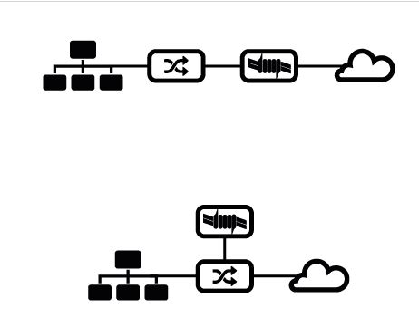
NAC Architecture
Inline
Out of Band

Slide 172
Inline System
Deployed in network path between switches and core routers
Typically includes multiple interfaces to accommodate multiple network paths through the system
Endpoint detection is achieved by listening to the IP traffic passing through the NAC device

Slide 173
Inline System
Since it is deployed inline in the network, an inline system doesn’t require an agent installed on endpoints to perform passive endpoint detection
Policy enforcement is done at the access layer of the network, because inline NAC has the ability to control individual packets passing through the inline NAC device, making it similar to an internal firewall

Slide 174
Inline System Weaknesses
Single point of failure: Device can be configured to “fail open” to avoid network outages, but loses the policy enforcement capability
Inline NAC limits network traffic throughput based on the processing speed of the hardware, requiring multiple NAC units deployed across an enterprise network and raising the implementation cost
Deployment of inline NAC requires architectural changes to network topology

Slide 175
Inline System Weaknesses
Typically deployed at the switch uplink, leaving local traffic on switches unprotected
Passive endpoint detection limits the amount of intelligence that can be gathered on endpoints
Vulnerability scanner is used to assess unmanaged endpoints
Firewalls on these endpoints limits the usefulness of these scans

Slide 176
Out-of-Band Systems
Typically use a span port on the switch to passively monitor traffic
The NAC console can send commands to network switches to enforce policy, such as assignment to quarantine VLAN
Enforcement option on the network switch is limited to the configuration allowed on switchport (e.g., VLAN assignment)

Slide 177
Out-of-Band Systems
Can be deployed to an existing infrastructure with ease
Optionally, agent can be installed on endpoint to report information to a central NAC console, allowing more enforcement options, such as remediation of out-of-date antivirus definitions

Slide 178
Out-of-Band System Weaknesses
Lacks the inline blocking capability
Requires a managed switch configurable via management protocol (e.g., SSH or SNMP) for quarantine and VLAN assignment
Span port on switches must be connected back to a central NAC controller, limiting the deployment with physical distance

Slide 179
Discussion

Slide 180
Architecture Flaws

Slide 181
Endpoint Detection Method
NAC solutions typically sniff network traffic to detect the presence of a new endpoint
This can be done by analyzing traffic for ARP request, SYN request, DHCP request or any other network traffic
DHCP request detection can be bypassed using a static IP

Slide 182
Endpoint Detection Method
SYN requests and IP network traffic detection can be bypassed by not generating network traffic crossing the inline NAC device
The attacking endpoint can stay silent on the LAN and target a specific host within its subnet without being detected
This allows the attacking endpoint to infect other endpoints on the same subnet, possibly taking control and acting as a launch pad for further network attacks

Slide 183
Exception Rules
Many devices within the network often lack the capability to respond to interrogation from the NAC system
E.g., a printer
Exception rules are used to handle these devices and allow them access to network without authentication

Slide 184
Exception Rules
Exception rules often rely on just the MAC address of the printer for identification. No other information is gathered.
An attacking endpoint can spoof the MAC address of printers within the network environment and gain access to network resources

Slide 185
Endpoint Security Assessment
Endpoint intelligence is gathered by the NAC solution to identify the OS version, patch level, antivirus engine version, virus definition, etc.
The information is typically stored in the OS registry system
A compromised machine can be modified to reflect falsified information to the NAC solution, gaining access to network without the actual required software (e.g., antivirus)

Slide 186
Discussion

Slide 187
Extensible Authentication Protocol

Slide 188
Overview
EAP is an authentication framework to provide authentication in wireless networks and point-to-point connections
Defines the message format used to deliver the keying material and parameters of EAP methods
EAP methods provides authentication functions and negotiation

Slide 189
LEAP
Lightweight Extensible Authentication Protocol
Developed by Cisco as part of 802.1x and dynamic WEP
Widely used by third-party client software for wireless devices
LEAP uses a modified version of MS-CHAP and has been exploited by ASLEAP
Mostly replaced by PEAP or EAP-TLS

Slide 190
PEAP
Second-most widely supported EAP standard
Protected EAP uses an encrypted TLS tunnel to encapsulate the EAP, providing higher security measure against attack
PEAP uses server-side public key for server authentication and server-side PKI certificate for the TLS tunnel creation

Slide 191
PEAP
PEAPv0 with EAP-MSCHAPv2 is the most common PEAP
Supported by Windows versions NT4 SP4 and later
Due to the use of MSCHAPv2, PEAP is susceptible to dictionary attacks if the password hash and the challenge response are captured

Slide 192
EAP-TLS
Most widely supported EAP standard
EAP Transport Layer Security adds TLS protocol to the EAP authentication framework
EAP-TLS is considered the most secure EAP standard
Widely supported by manufacturers of wireless communication technologies

Slide 193
EAP-TLS
EAP-TLS requires client-side X.509 certificate implementation to increase the authentication strength
With client-side certificate authentication requirement, a compromised password is not enough to break into EAP-TLS system

Slide 194
EAP-MD5
EAP-MD5 was the first implementation of EAP framework
EAP using MD5 has function to hash keys
It is vulnerable to dictionary attacks and does not support key generation
It only authenticates the EAP peer to EAP server, not mutual authentication, making it susceptible to man-in-the-middle attacks

Slide 195
EAP-TTLS
EAP Tunneled Transport Layer Security is an extension of TLS
The client can optionally authenticate to server using certificate, simplifying the deployment process (no client cert)
The server uses the secured tunnel established to authenticate the client using many authentication protocols
The authentication process is protected by the tunnel from eavesdropping and man-in-the-middle attacks

Slide 196
Discussion

Slide 197
© 2017, Southern Alberta Institute of Technology. All rights reserved.
This publication and materials herein are protected by applicable intellectual property laws. Unauthorized reproduction and distribution of this publication in whole or part is prohibited.
For more information, contact:
Director, Centre for Instructional Technology and Development
Southern Alberta Institute of Technology
1301 16 Ave. N.W., Calgary, AB T2M 0L4

